Slide 1
CREATIVE AI
BY
M.CHAITHANYA-(2010030366)
VAIBHAV VENKATESWARAN-(2010030357)
Y.SAI BHARGAV-(2010030535)
N.RISHIK SAI-(2010030350)
GUIDED BY
ARPITHA GUPTHA

Slide 2
Introduction
Creative AI is a new branch of Artificial intelligence in which AI can create paintings, write compelling stories , and compose new music.
In particular, Deep Dream and Neural Style Transfer are algorithms, based on deep-learning convolutional neural networks (CNNs) that blend visual qualities from multiple source images to create a new output image.
Deep learning is a collection of network-based machine learning methods that are notable for their power and breakthrough performance in tasks such as object recognition as well as their similarities to aspects of human vision and brain function

Slide 3
Problem Statement
With the emergence of AI, it becomes easier for artists to express themselves without having to go through the process of creating an artwork. This can be seen as either a positive or negative thing, depending on how it is used. The role of AI in art creation and the relationship between the artist and AI are still evolving.
A lot of critics believe that AI will disrupt the art industry because it enables artists to express themselves more easily. It also eliminates some costly tasks such as drawing or painting which leaves less time for artists to have a chance at making a living from their art.

Slide 4
Objective
The goal is to enable people to use their products more quickly and eliminate the need for time-consuming manual operations. As AI and machine learning (ML) elements in digital art packages get more complex, new tools for artists to experiment within creative and unanticipated ways become available.
The artwork of an artificial intelligence will depend, as for an artist, on its learning and the images encountered. The difference between an artificial intelligence and an artist is the origin of its experiences. An artist will live and develop creativity around events in an uncertain environment. Conversely, it is the artist who will determine the environment and the learning rules of the artificial intelligence, which makes it dependent on the artist and places it as a tool.

Slide 5
Literature Review
s.NO | AUTHOR | TITLE | PUBLISHED YEAR | TECHNIQUE | DATASET | PROS
1 | Daniel Ambrosi | Dreamscapes | 2019 | AI-augmented" or human-AI hybrid art | He captured 50000 photos with XYZ photography technique(capturing, blending, and stitching together a cubic array of photos; multiple shots high x multiple shots wide x multiple exposures "deep") | By his latest model we are getting the image we accurately
2 | Mike. Tyka | Portraits. of. Imaginary. People | 2018 | neural. network to imagine and then depict. portraits of people who don't exist. | thousands. of. photographs of faces. taken from GAN | They get. the image. according to-their imagination. with high accuracy.
3 | Mario. Klingemann | Neural Glitch | 2019 | intelligence, evolutionary art, glitch. classification. and. visualization, and robotic, deep learning | uncharted. territories to. discover. unseen. beauty and unthought. ideas | He crossed. A the. limitations. of creatively. repurposing. and. recombining objects and. systems.to. reveal their. hidden. qualities

Slide 6
Data Set
DATA SET NAME | CHARACTERISTICS | TECHNIQUES
MARS_EFFIEL DEEPDREAM | 200 screenshots of the mars and effiel tower were taken to make the data set | Google's Deep Dream Algorithm using pre trained networks or use them various applications (computer vision, image processing)
BVLC ImageNet dataset | The bundled model is the iteration 2,400,000 snapshot (60 epochs) using quick_solver.prototxt This bundled model obtains a top-1 accuracy 68.7% (31.3% error) and a top-5 accuracy 88.9% (11.1% error) on the validation set, using just the center crop. (Using the average of 10 crops, (4 + 1 center) * 2 mirror, should obtain a bit higher accuracy.) | not training with the relighting data-augmentation; not training with the scale or aspect-ratio data-augmentation;
CompCars dataset. | This is the GoogLeNet model pre-trained on ImageNet classification task and fine-tuned on 431 car models in CompCars dataseT | The correspondence between the output nodes of the network and the 431 car models can be viewed

Slide 7
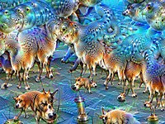
Methodlogy
Deep Dream
The software is designed to detect faces and other patterns in images, with the aim of automatically classifying images.[10] However, once trained, the network can also be run in reverse, being asked to adjust the original image slightly so that a given output neuron (e.g. the one for faces or certain animals) yields a higher confidence score. This can be used for visualizations to understand the emergent structure of the neural network better, and is the basis for the DeepDream concept. This reversal procedure is never perfectly clear and unambiguous because it utilizes a one-to-many mapping process.[11] However, after enough reiterations, even imagery initially devoid of the sought features will be adjusted enough that a form of pareidolia results, by which psychedelic and surreal images are generated algorithmically. The optimization resembles backpropagation, however instead of adjusting the network weights, the weights are held fixed and the input is adjusted.
Applying gradient descent independently to each pixel of the input produces images in which adjacent pixels have little relation and thus the image has too much high frequency information. The generated images can be greatly improved by including a prior or regularizer that prefers inputs that have natural image statistics (without a preference for an
particular image), or are simply smooth. For example, Mahendran et al. used the
total variation regularizer that prefers images that are piecewise constant. Various
regularizers are discussed further in. An in-depth, visual exploration of feature v
isualization and regularization techniques was published more recently.
The dreaming idea can be applied to hidden (internal) neurons other than those in
the output, which allows exploration of the roles and representations of various parts of the network. It is also possible to optimize the input to
satisfy either a single neuron (this usage is sometimes called Activity Maximization) or an entire layer of neurons

Slide 8
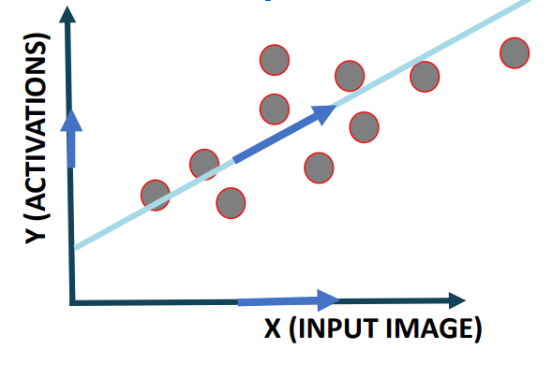
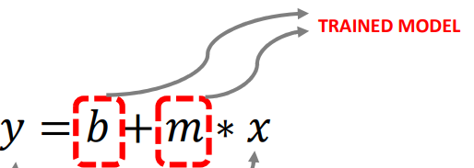
Computers aren't making art. Not yet, anyway. And they aren't dreaming, either. Both of those processes are distinctly human and are affected profoundly by personal culture, physiology, psychology, life experiences, geography and a whole lot more. Computers may absorb a lot of data regarding those variables, but they don't experience and process them the same way as people. So if you're worried that technology is making your human experiences obsolete, don't fret just yet. Your perception of the world goes a whole lot deeper than that of a computer network.
Deep Dream Steps:
1. Forward an image through a trained ANN, CNN, ResNet..etc
2. Select a layer of choice (first layers capture edges, deep layers
capture full shapes such as faces)
3. Calculate the activations (output) coming out from the layer of
interest.
4. Calculate gradient of loss (activations) with respect to the pixels of
the input image.
5. Modify the image to increase these activations, and thus enhance
the patterns seen by the network resulting in trippy hallucinated image

Slide 9
Functional and Non-Functional Requirements
Functional Requirements
Make sure you are working in the software which supports the desired language such as Python, Java, C, etc. where in this project we have used Google colab.
Non-Functional Requirements
• Reliability
• Performance
• Maintainability
• Serviceability
• Data Integrity
• Usability
• Recoverability

Slide 10
Algorithm
• When you feed in an image to a trained ANN, the neurons fire and generate activations.
• The deep dream algorithm work by trying to change the input image in a way that would make some of these neurons fire more (boost the neurons firing or activations). You can select which neurons in which layer you are interested in making them fire more prominently.
• The process is continuously repeated until the input image now contains all features that a specific layer was originally looking for.
• Example: if a certain layer was expert in recognizing dog faces and you feed in an image of a blue sky, the deep dream algorithm will continuously change the input image and start creating images of dogs faces on top of the blue sky. The process keep repeating until the layer of interest is happy with the results!

Slide 11
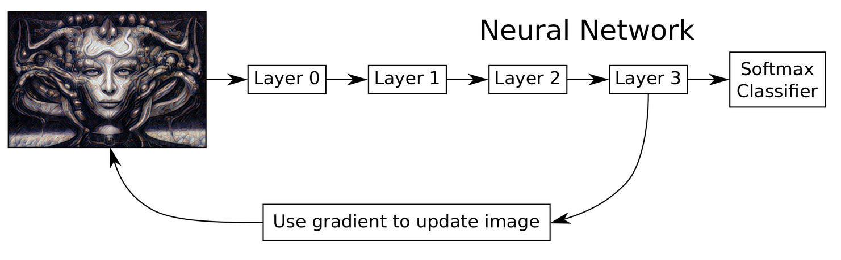

Slide 12
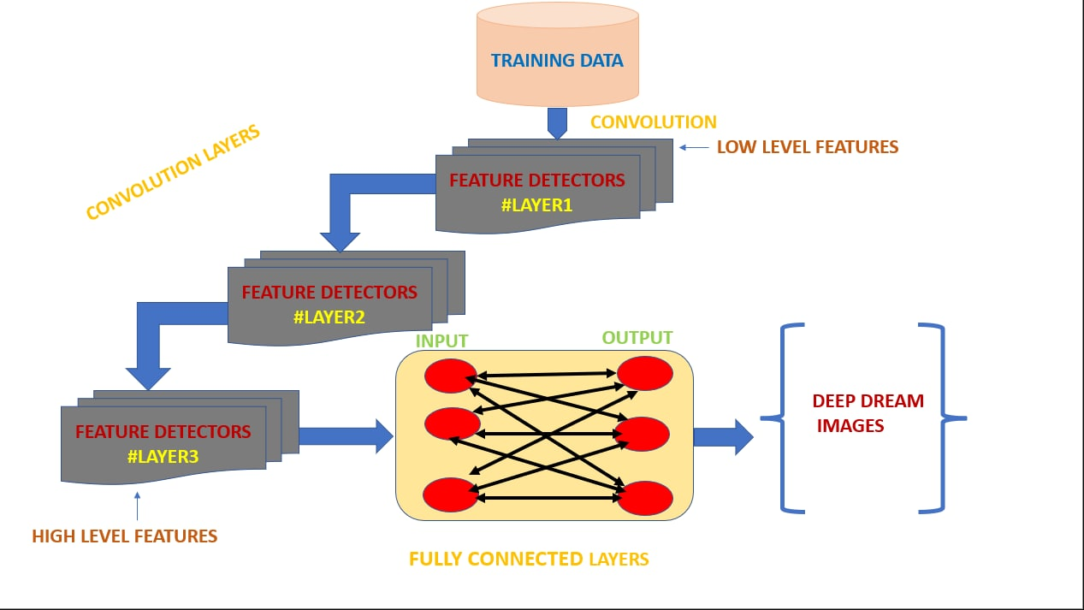
FLOW DIAGRAM

Slide 13
Techniques
Python Imaging Library(PIL) –Python Imaging Library is a free and open-source additional library for the Python programming language that adds support for opening, manipulating, and saving many different image file formats.
Google Deep Dream – Deep dream is a computer vision algorithm developed at Google. The algorithm works by creating dream-like effect. It’s like giving humans an extremely powerful drug!. As the image is increasingly feed to the network, more weird features will start to pop up.
GOOGLE COLAB
Deep Dream Generator – Stylize your images using enhanced versions of Google Deep Dream with the Deep Dream Generator. Get your Deep Art on.

Slide 14
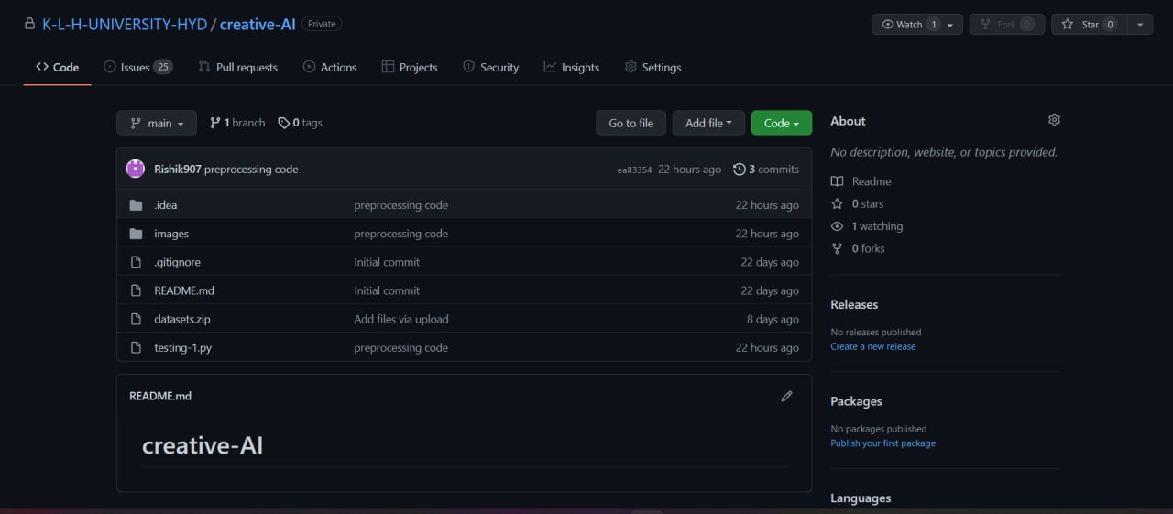
Github Commits

Slide 15
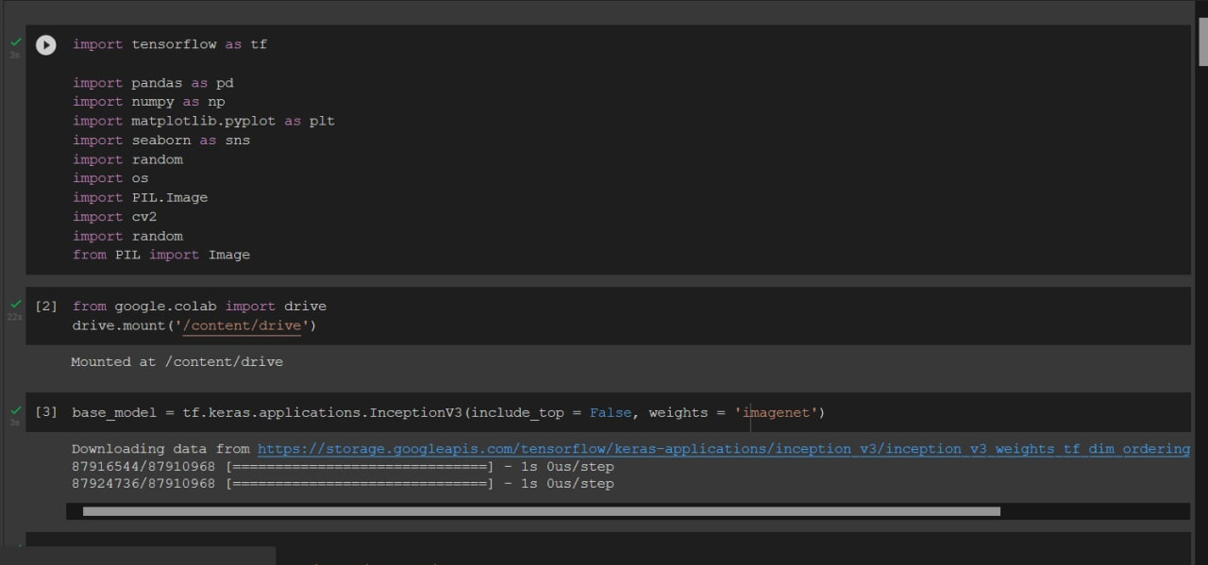
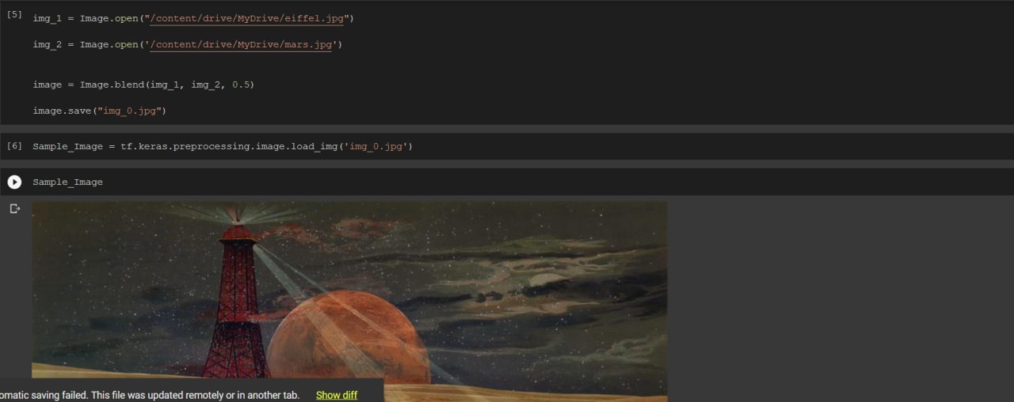
Preprocessing Code

Slide 16
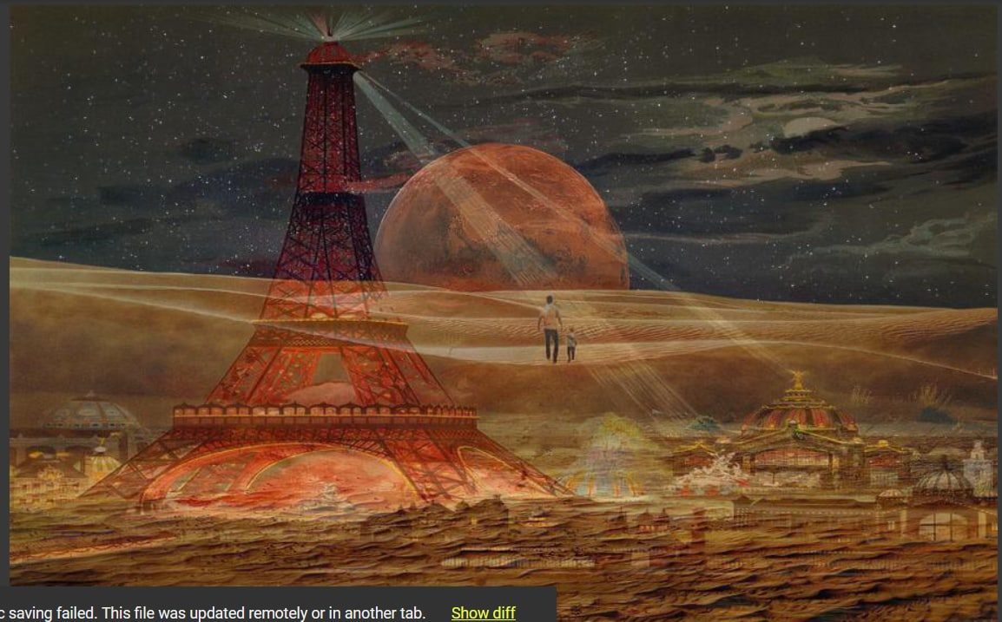
Output For Preprocessing Code

Slide 17
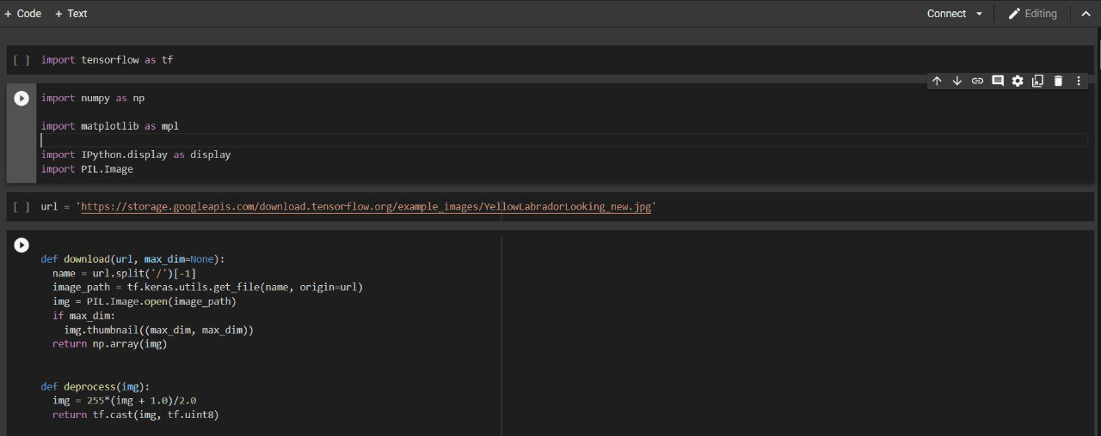
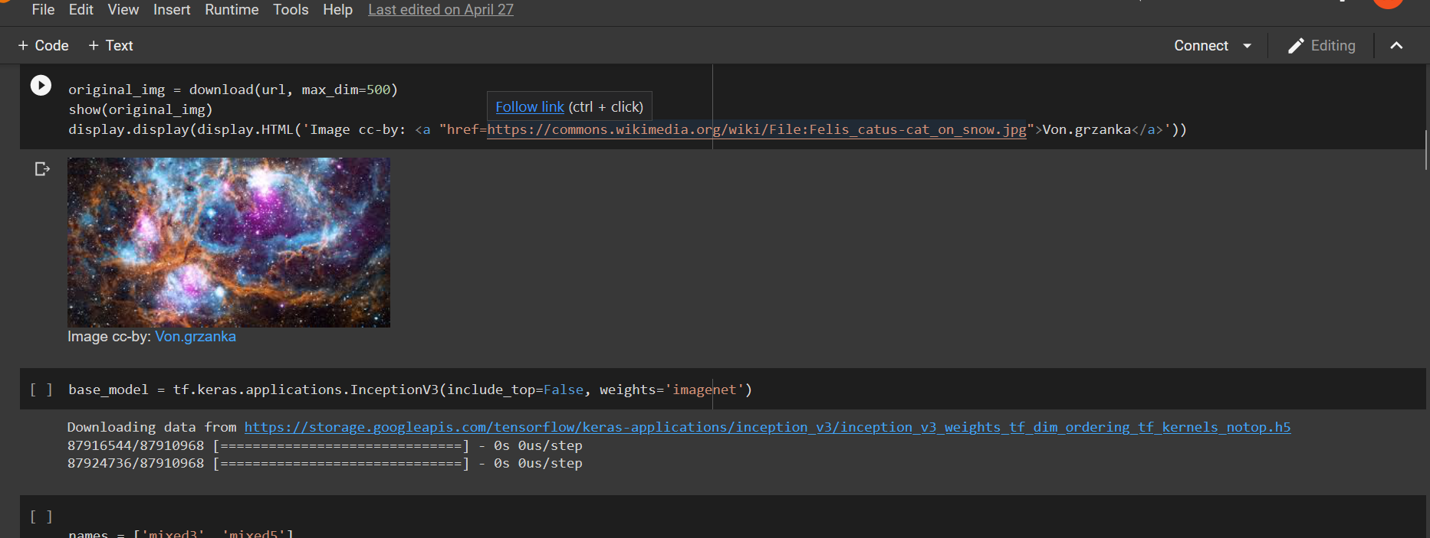
Implementation

Slide 18
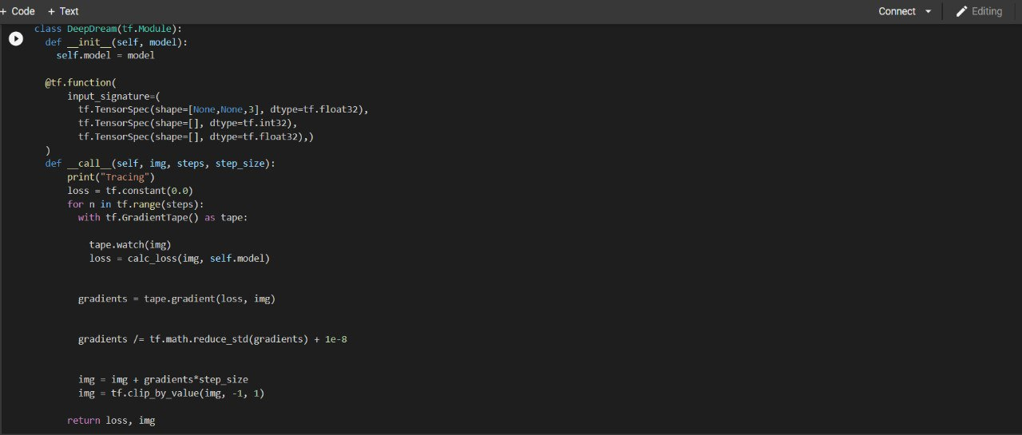
Implementation

Slide 19
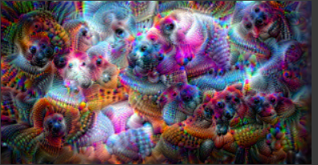
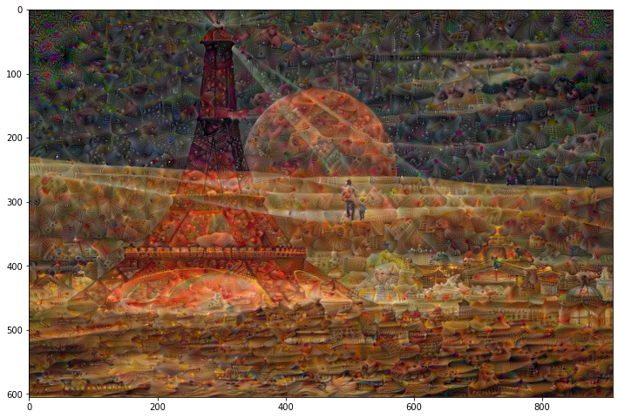
Results

Slide 20
Conclusion
We suggest that the use of deep neural networks (with ac-companying search/optimization algorithms) to produce creative visual blends and arti facts has entered a new and promising phase, both for models of creativity and for practical art-generating systems
Future scope
We are want to develop a real time application for the deep dreams. In that we are going to make a live photo make it as a deep dream image

Slide 21
References
For datasets we referred -http://sprawledoctopus.com/deepdream/datasets/
For Author’s articles we referred -
https://aiartists.org/mike-tyka
https://aiartists.org/alexander-mordvintsev
https://aiartists.org/daniel-ambrosi
https://aiartists.org/tom-white

Slide 22
THANK YOU

